Slide 1
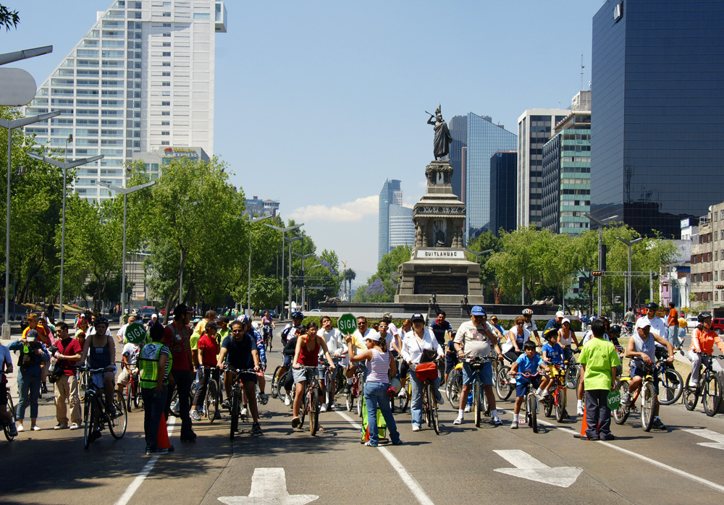
Flickr, Michael Roberts

Slide 2
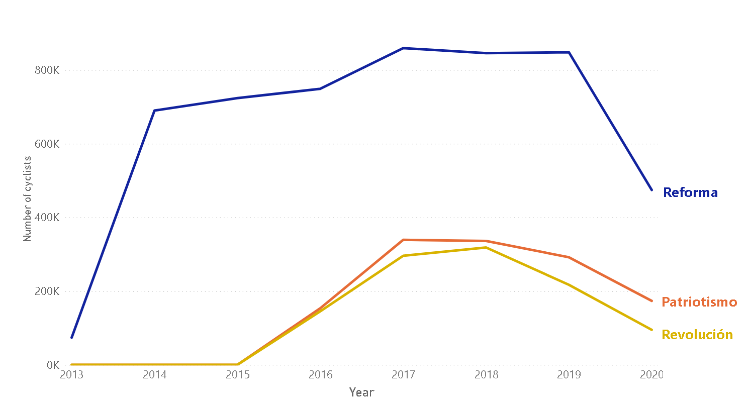
Every day there are more cyclists in Mexico City…
¿COVID-19?
Source: Contador ciclistas, Datos Abiertos CDMX

Slide 3
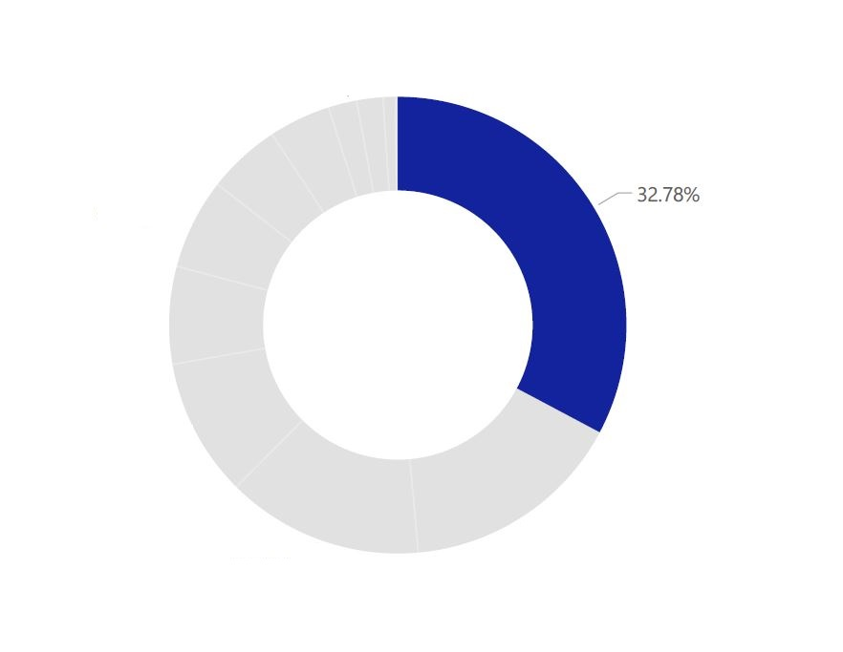
…but most of them are still afraid of suffering an accident.
Injury or disability
Source: Estudio de Conteo Ciclista 2018, Datos Abiertos CDMX

Slide 4
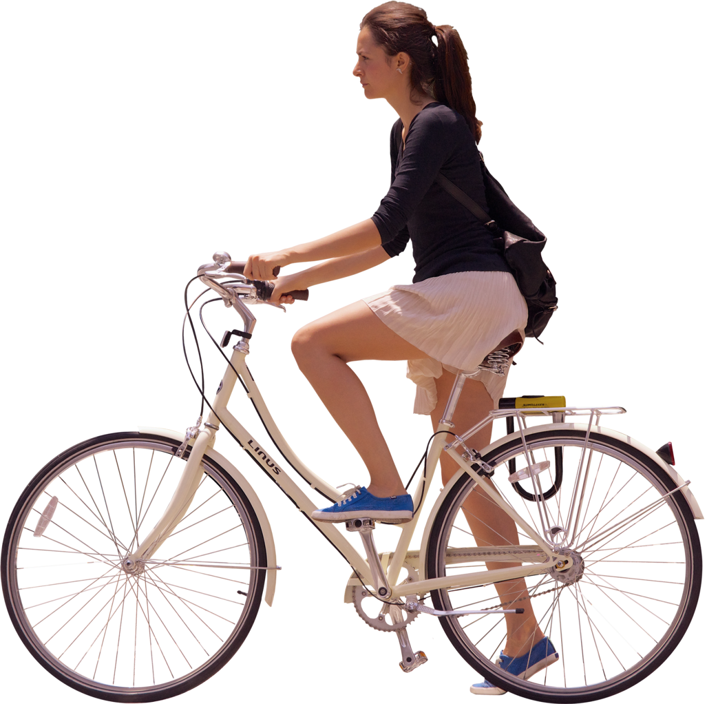
Ana wants to cycle without risk. ¿How could she do it?
1
Month
2
Day
3
Hour
4
Area

Slide 5
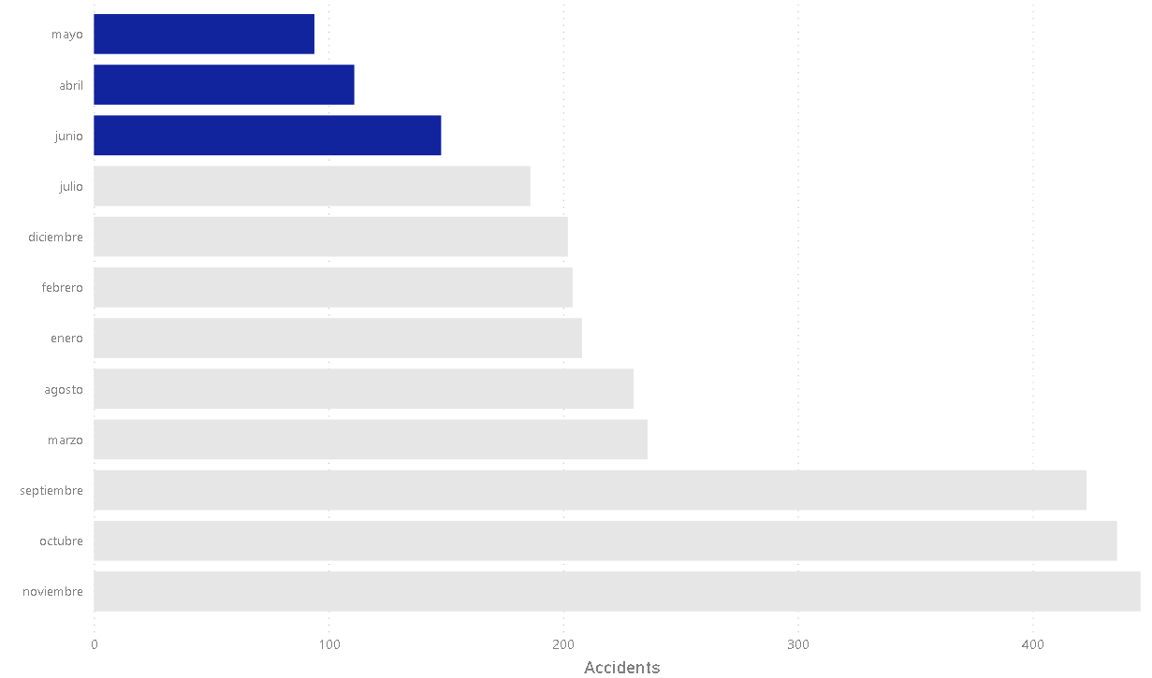
Summer is the safest time.
Source: Incidentes viales reportados por C5, Datos Abiertos CDMX

Slide 6
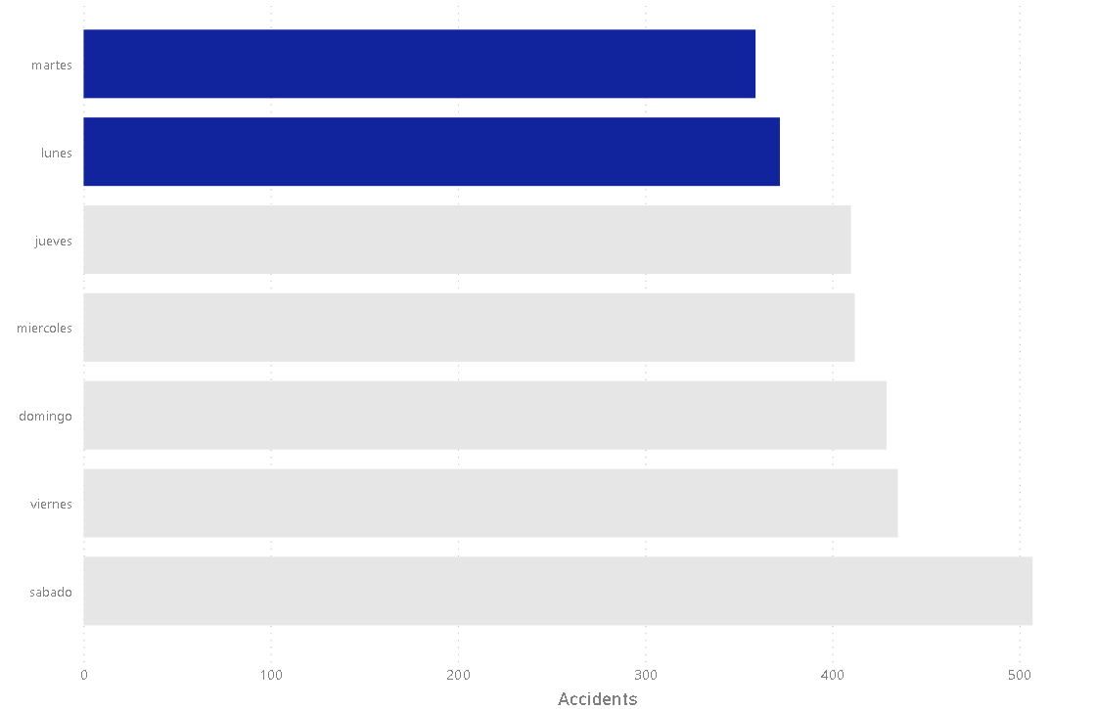
The beginning of the week is the safest time to go out…
Source: Incidentes viales reportados por C5, Datos Abiertos CDMX

Slide 7
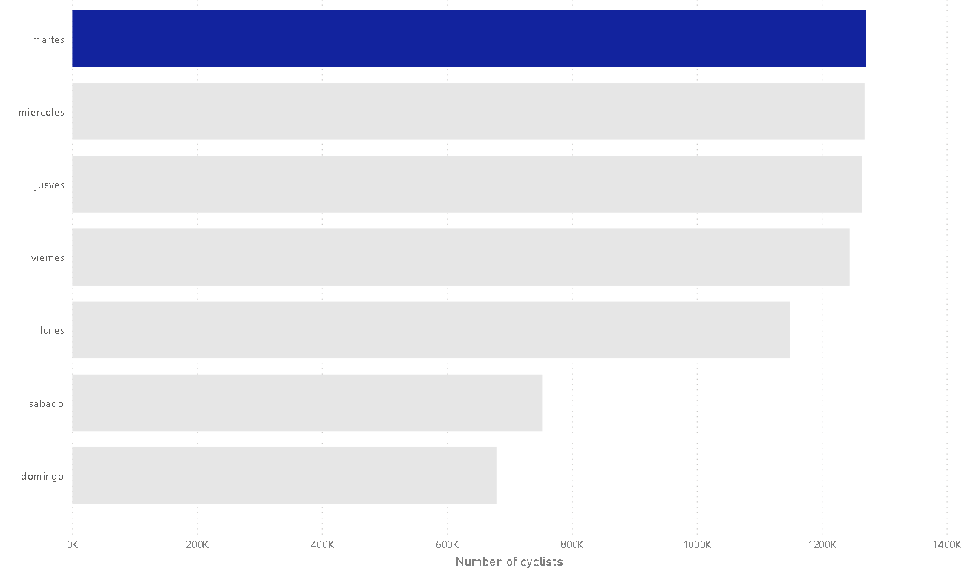
…even considering the amount of people per day.
Source: Contador ciclistas, Datos Abiertos CDMX

Slide 8
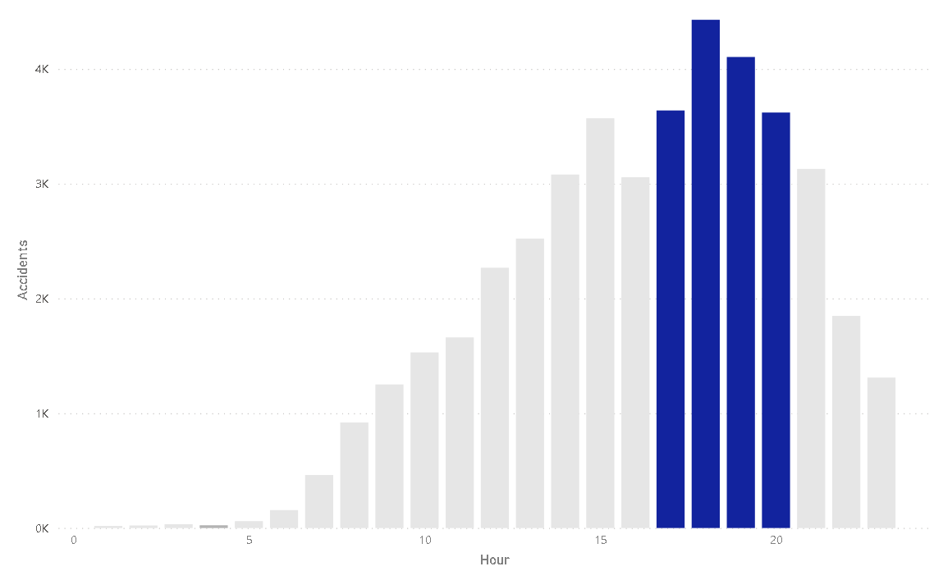
As the sun goes down, there are more accidents.
Source: Incidentes viales reportados por C5, Datos Abiertos CDMX

Slide 9
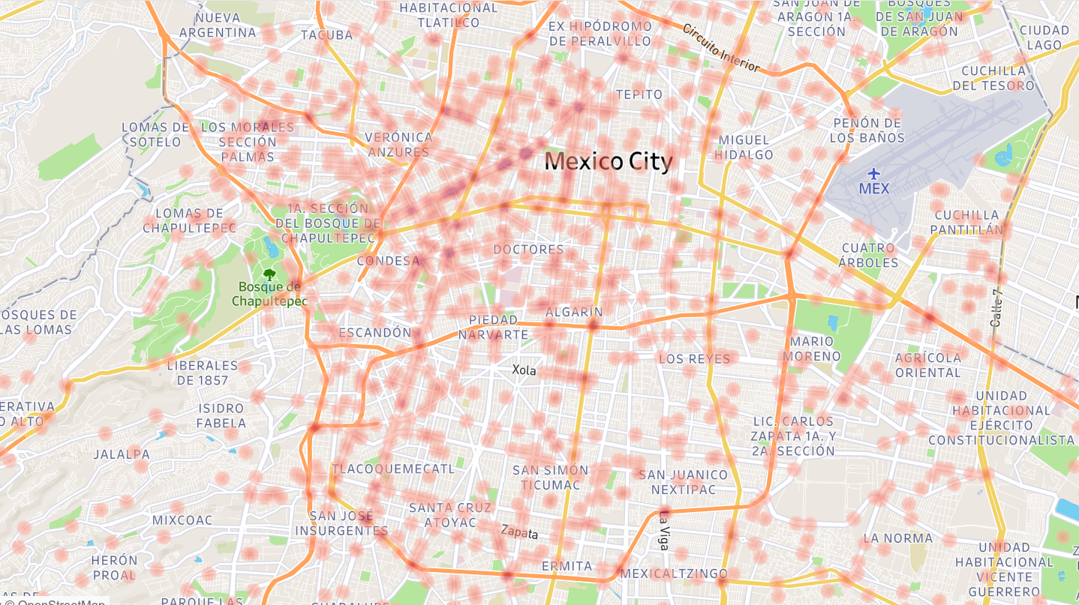
Source: Incidentes viales reportados por C5, Datos Abiertos CDMX

Slide 10
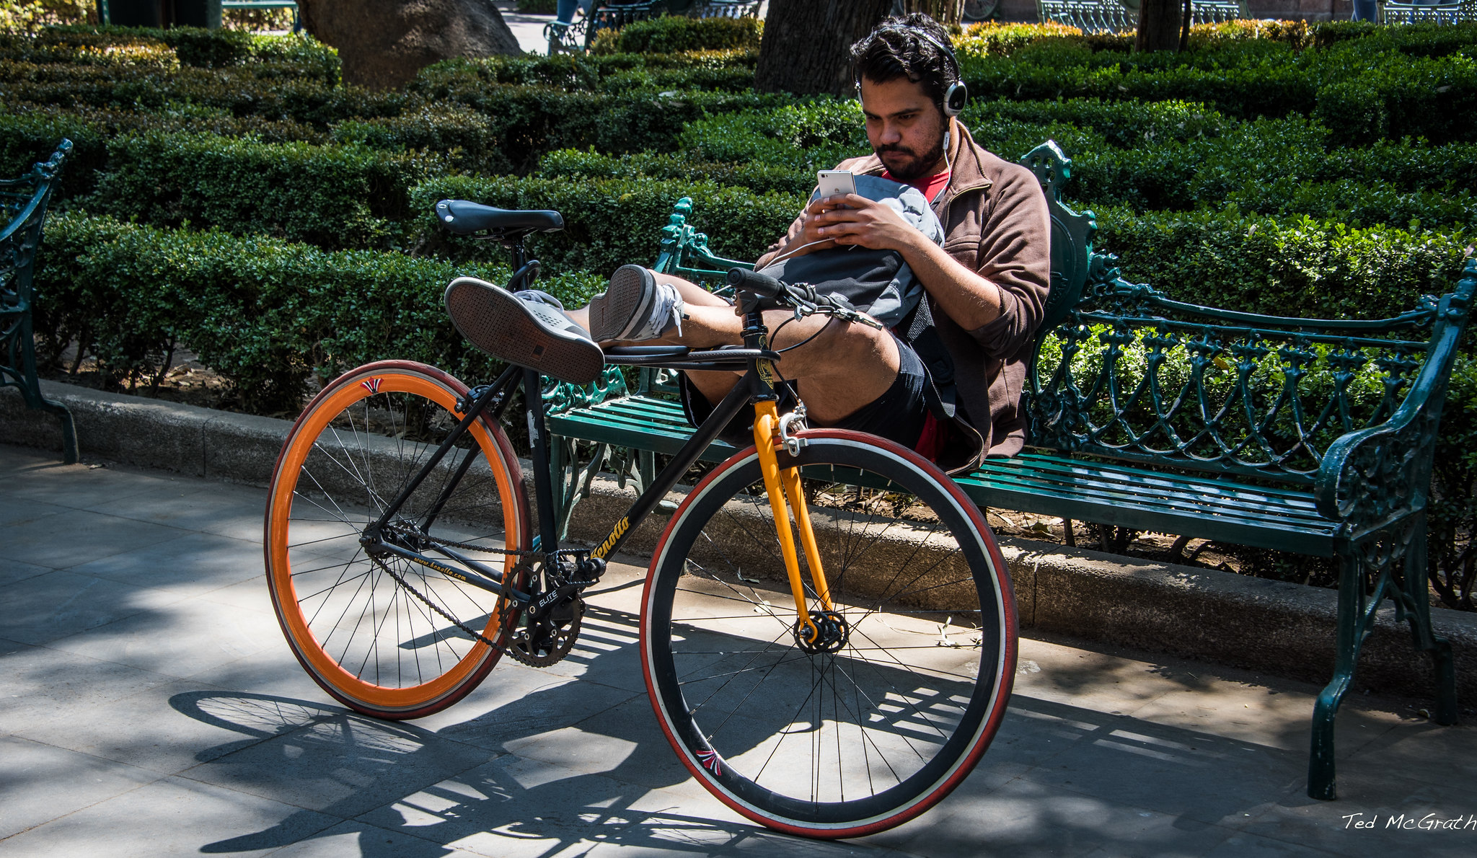
Tuesday at noon, during the summer at the Del Valle area…
Flickr, Ted McGrath

